Slide 1






DSA Project
MINESWEEPER
By Group “JQKA”

Slide 2

02
THÁI THÀNH PHÁT
ITITIU21274
DSA Project
MINESWEEPER
01
04
VÕ HOÀI BẢO
ITITIU21038
By Group “JQKA”
PHẠM TRUNG DŨNG ITITIU21007
03
NGUYỄN ĐỨC DUY
ITITIU21008

Slide 3
TABLE OF CONTENTS
DSA Project
CONTRIBUTORS
02
01
02
03
04
05
06
07
01
03
04
MINESWEEPER
VÕ HOÀI BẢO
ITITIU21038
THÁI THÀNH PHÁT
ITITIU21274
NGUYỄN ĐỨC DUY
ITITIU21008
PHẠM TRUNG DŨNG ITITIU21007
By Group “JQKA”
Introduction
Game Rules
UML & Git
Data Structure & Algorithm
Features & Design Pattern
Demo
Q&A
Introduction
Game Rules
Git
Data Structure & Algorithm
UML & Other classes
Demo
Q&A

Slide 4
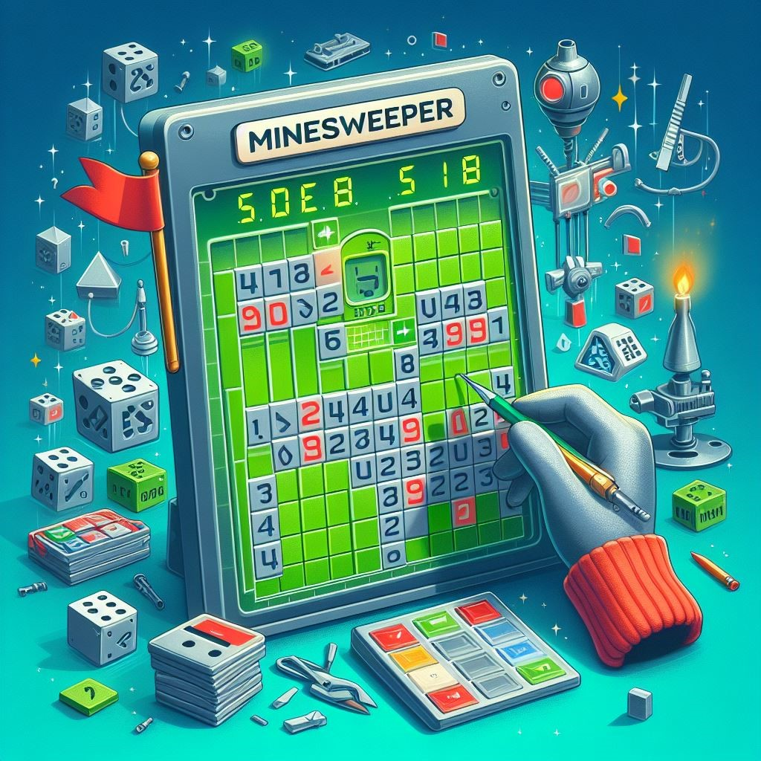
TABLE OF CONTENTS
Introduction
Game Rules
UML & Git
Data Structure & Algorithm
Features & Design Pattern
Demo
Q&A
01
02
03
04
05
06
07
01
02
03
04
VÕ HOÀI BẢO
ITITIU21038
THÁI THÀNH PHÁT
ITITIU21274
NGUYỄN ĐỨC DUY
ITITIU21008
PHẠM TRUNG DŨNG ITITIU21007
INTRODUCTION
CODED BY JAVASCRIPT
- A Childhood game.
- Use intelligence to figure out the bombs.

Slide 5
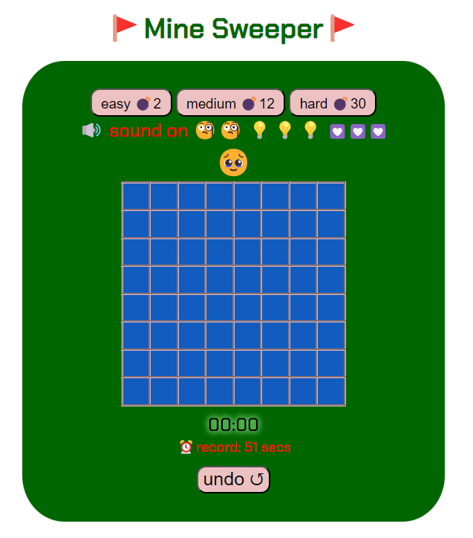


Introduction
Game Rules
UML & Git
Data Structure & Algorithm
Features & Design Pattern
Demo
Q&A
01
02
03
04
05
06
07
- Left Click to unlock a square
- Right Click to place a flag
- Click on the bomb -> LOSE !
INTRODUCTION
CODED BY JAVASCRIPT
- A Childhood game.
- Use intelligence to figure out the bombs.
GAME RULES
TABLE OF CONTENTS

Slide 6
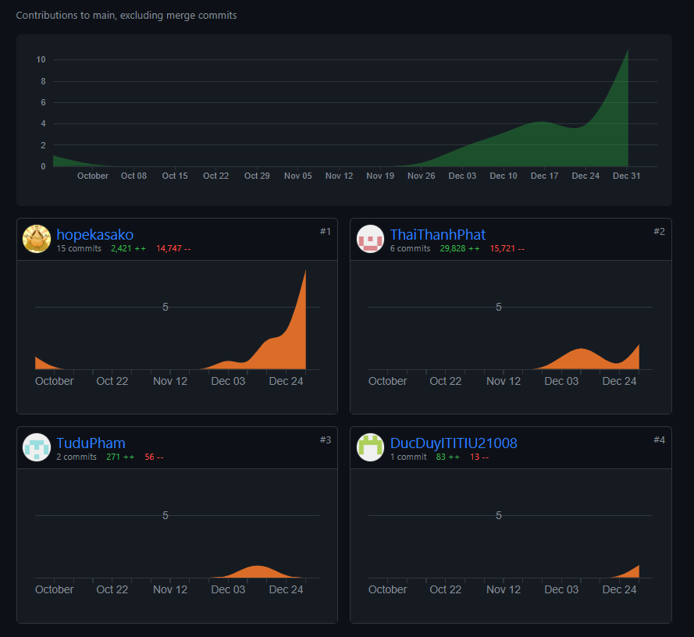
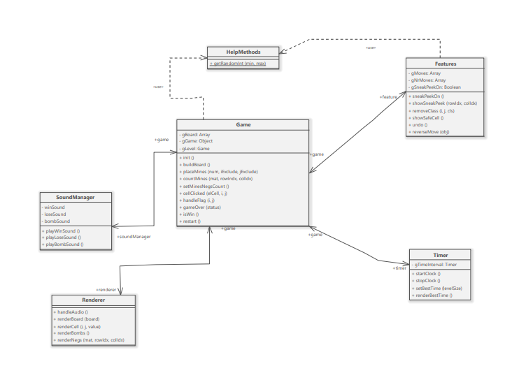


- A Childhood game.
- Use intelligence to figure out the bombs.
CODED BY JAVASCRIPT
GAME RULES
INTRODUCTION
- Left Click to reveal a cell
- Right Click to place a flag/ unflag
- Click on the bomb -> LOSE !
3 levels
New features

Slide 7



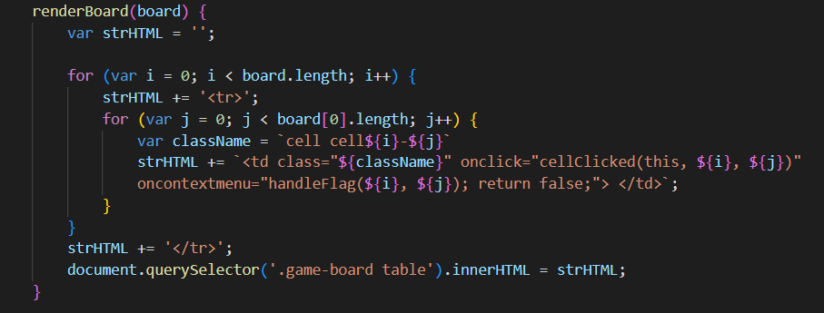

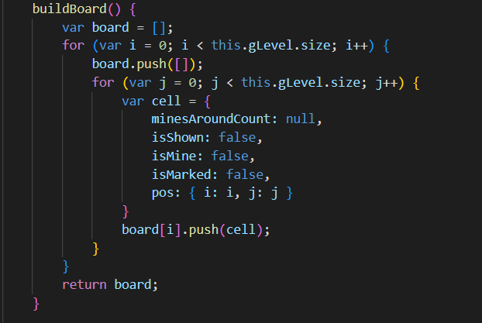

DATA STRUCTURE & ALGORITHM
GIT CONTRIBUTION
01
02

Slide 8
DATA STRUCTURE & ALGORITHM
UML
- Left Click to unlock a square
- Right Click to place a flag
- Click on the bomb -> LOSE !
GIT CONTRIBUTION
Time complexity : O(N^2)

Slide 9

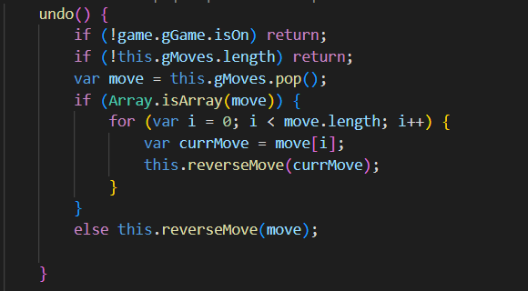
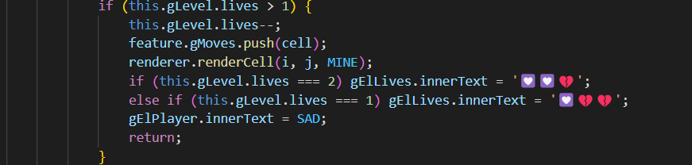
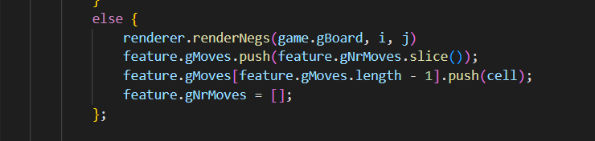
DATA STRUCTURE & ALGORITHM
DATA STRUCTURE & ALGORITHM
Time complexity : O(N^2)
GIT CONTRIBUTION

Slide 10
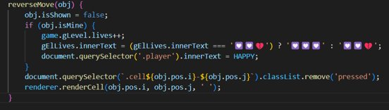
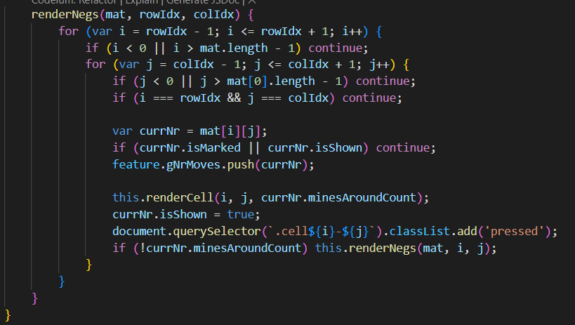
DATA STRUCTURE & ALGORITHM
DATA STRUCTURE & ALGORITHM
Time Complexity : O(1)
DATA STRUCTURE & ALGORITHM

Slide 11
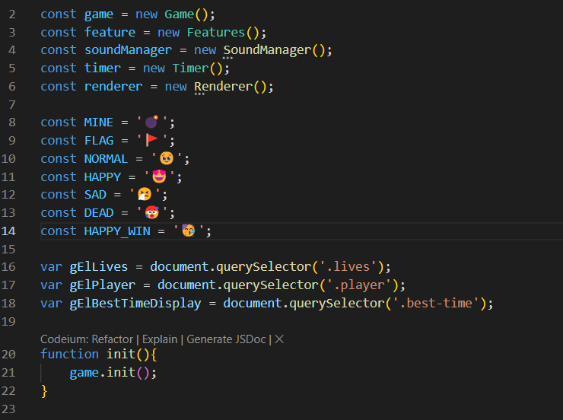
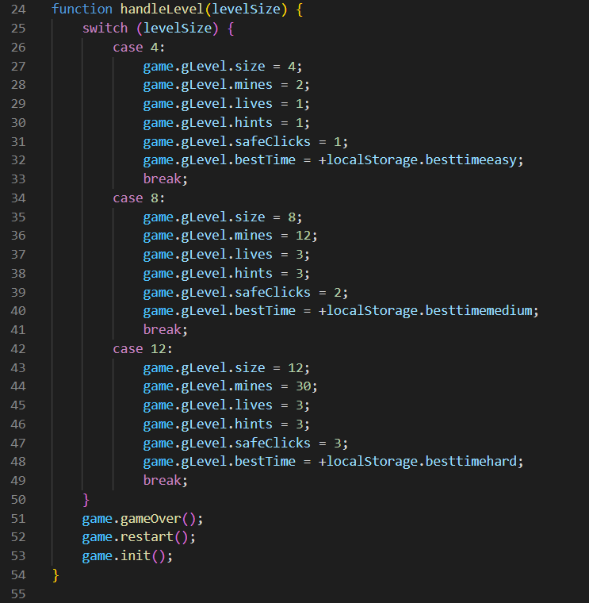
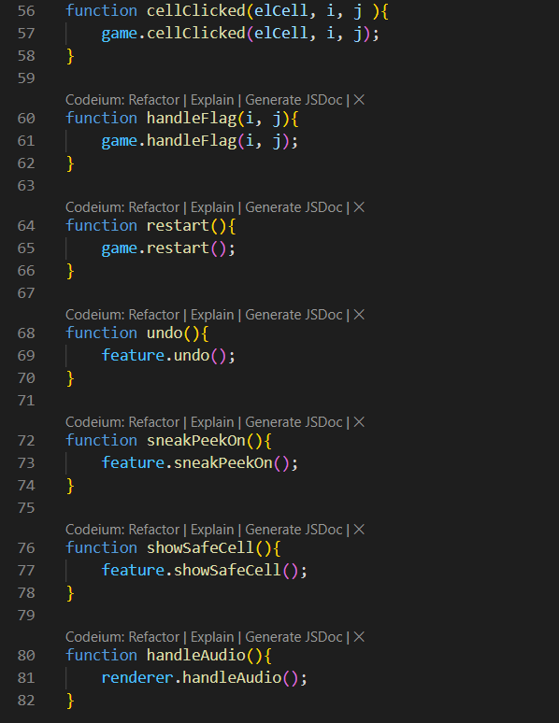
Time Complexity : O(1)
script.js
DATA STRUCTURE & ALGORITHM
DATA STRUCTURE & ALGORITHM

Slide 12
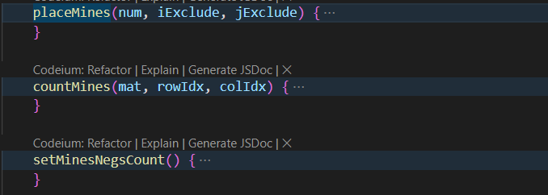


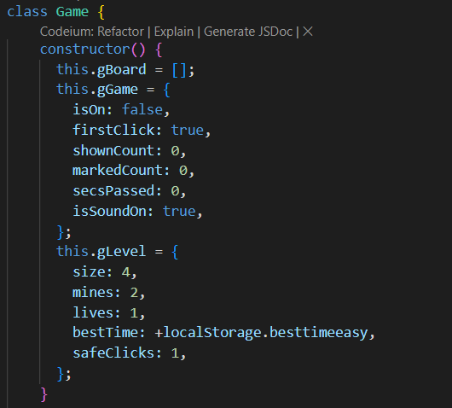
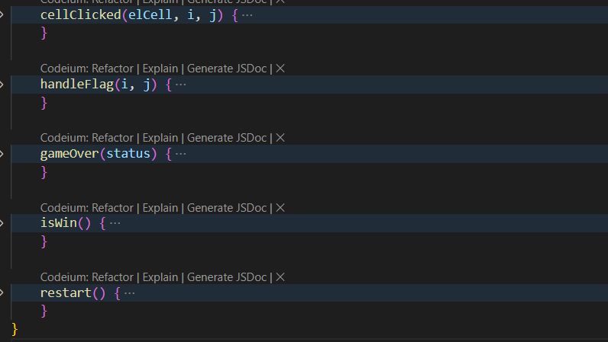


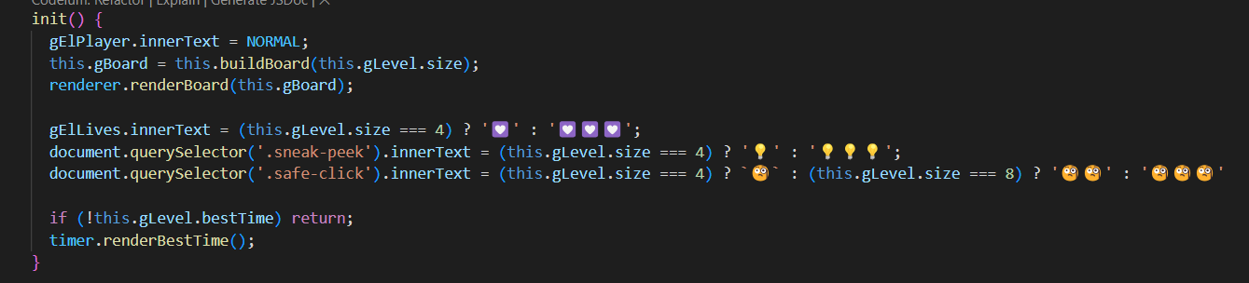
script.js
Game.js
DATA STRUCTURE & ALGORITHM

Slide 13
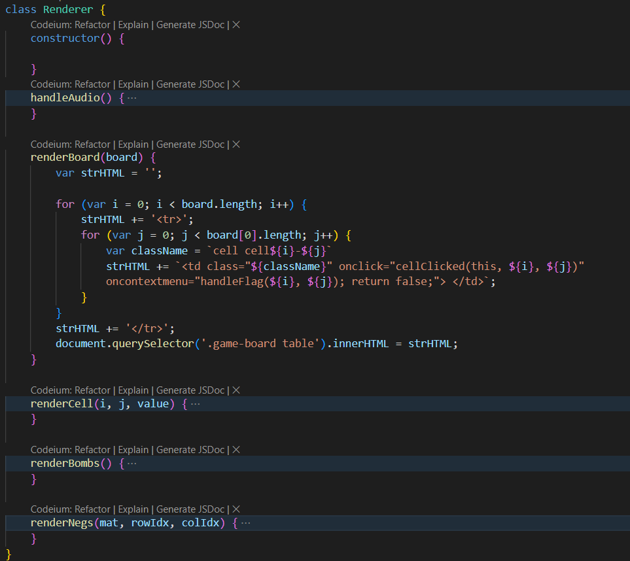
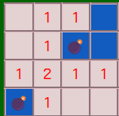
Game.js
Renderer.js

Slide 14
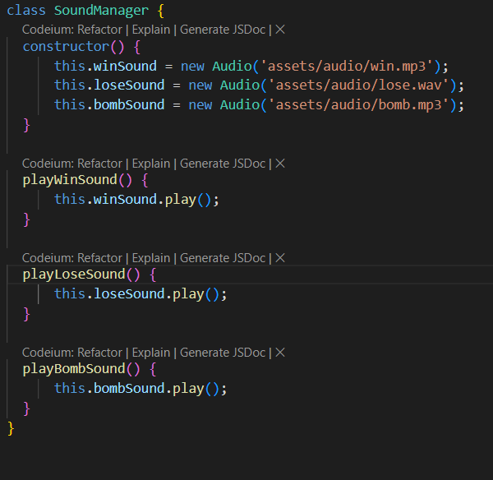
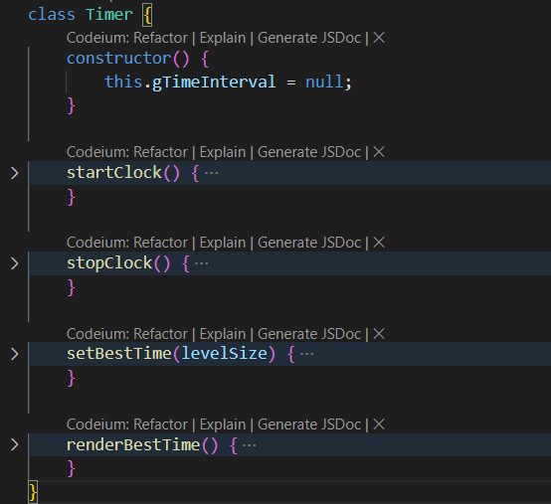
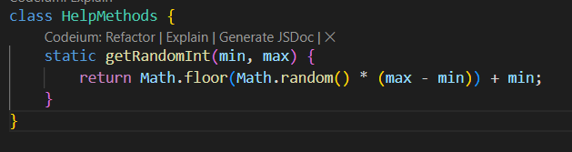
Renderer.js
Other Classes

Slide 15
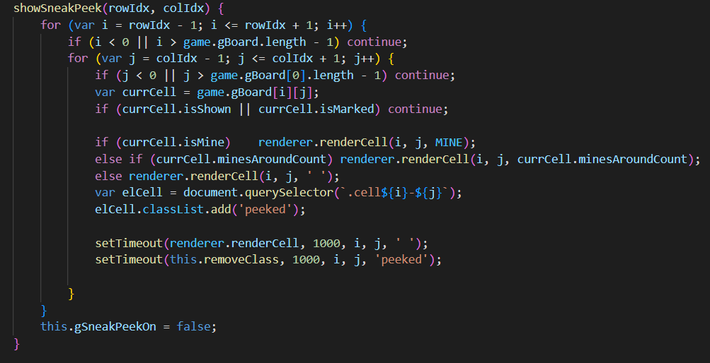



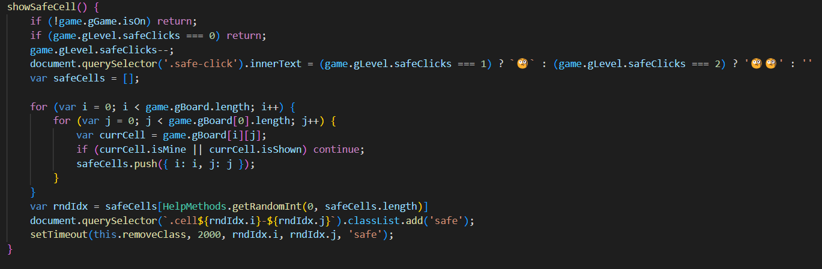
Other Classes
Renderer.js
sneak peek
Safe cell
Undo button
New features

Slide 16
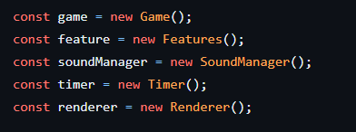
Singleton Pattern
New features
sneak peek
Safe cell
Undo button

Slide 17


Singleton Pattern
GAME DEMO

Slide 18

THANK YOU
FOR LISTENING !
GAME DEMO
Singleton Pattern
Q&A TIME!

Slide 19
THANK YOU
FOR LISTENING !
Q&A TIME!
Thank you for listening
GAME DEMO

Slide 20
02
THÁI THÀNH PHÁT
ITITIU21274
Thank you for listening
01
04
VÕ HOÀI BẢO
ITITIU21038
PHẠM TRUNG DŨNG ITITIU21007
03
NGUYỄN ĐỨC DUY
ITITIU21008
Q&A TIME!

Slide 21




RESOURCE PAGE

